Slide 1

MARKETING PRESENTATION
INVINCIBLES 3.0
Osmania University
Hyderabad, Telangana

Slide 2
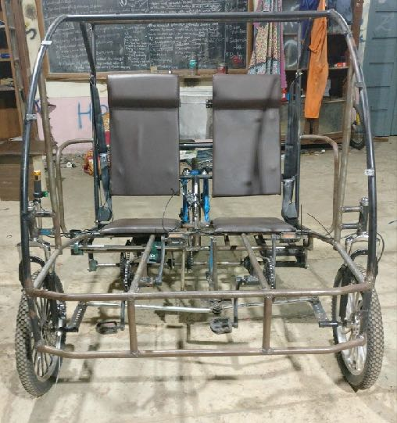
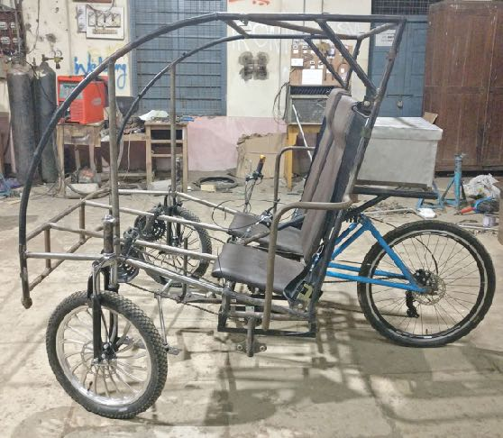
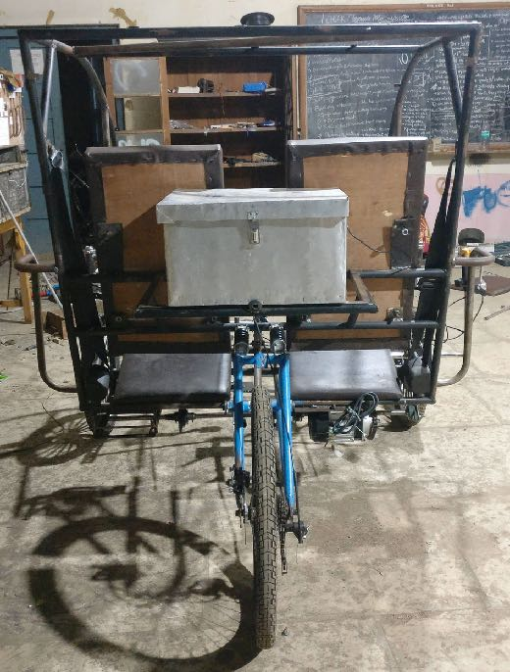

VIEWS
OF
VEHICLE
FRONT VIEW
SIDE VIEW
REAR VIEW

Slide 3
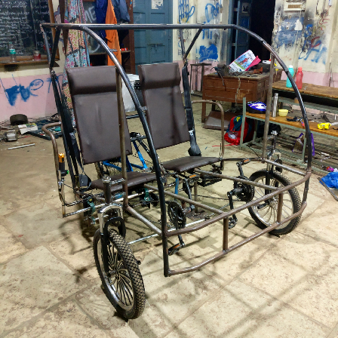
DIMENSIONS AND WEIGHT
Kerb weight = 130 kgs
Wheel base = 52”
Track width = 52.5”
Height = 59.75”
MATERIAL SPECIFICATION
AISI 1018 for roll cage
Stainless steel for steering tie rods
EN 24 (MS Bright) for shaft
TRANSMISSION
Solid Shaft - 44.5”, 20mm diameter
48 V , 750 W BLDC Motor
BRAKING
Mechanical disc brakes
Rotor diameter-- Front - 160mm
-- Rear - 170mm
Brake Callipers - Aluminium Alloy.
BRAKING
Mechanical disc brakes
Rotor diameter -- Front - 160mm
-- Rear - 170mm
Brake Callipers - Aluminium Alloy.
WHEELS
( Alloy, Spokes )
Front Diameter -- 20”
Rear Diameter -- 26”
SUSPENSION
Rear Coil Spring
Suspension
Length -- 4”
Spring Travel -- 42mm
Front Suspension Forks
Spring Travel -- 1.25”
STEERING
Lever Mechanism
Steering ratio = 1:1

Slide 4
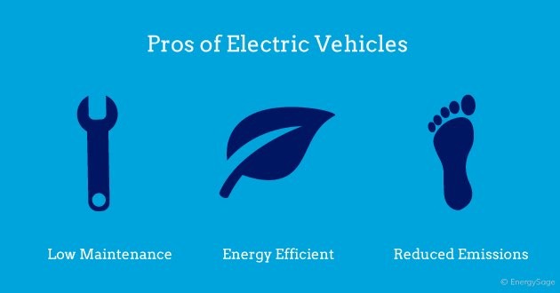
UNIQUE SELLING PROPOSITION (USP)
The market is the target, the quality is the bullet.
Fit India - Green India.
Small is the new big.
Driven by what’s inside!!
Engineered to move the
human spirit.
GST rate reduction on
electrical vehicles.

Slide 5

DIFFERENT CONCEPTS AND VARIANTS
Monocoque design- light weight and strong.
Maestro rear suspension and MTB Suspension forks-
more efficient for rough terrains
Tubeless tyres
Electronics and communication - Bluetooth and Wifi

Slide 6
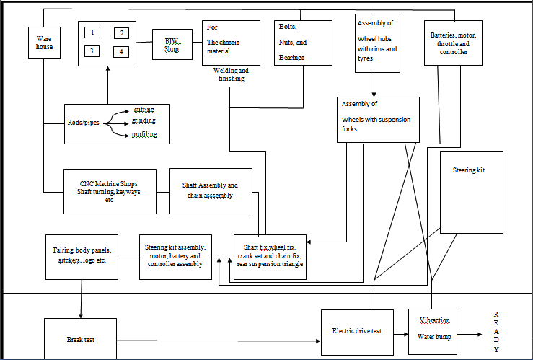
PLANT LAYOUT FOR MASS PRODUCTION
MACHINERY
Amsler’s testing machine.
Brinell’s hardness testing machine.
MIG/ MAG welding machine.
Lathe machine.
Assembly line.
Auto machinery. ( robotic equipment ).
CNC Machines.
INVESTMENT
Area = 13 lakhs
Construction = 7.5 lakhs
Machinery & tools = 22 lakhs
Others ( Bills, Permits, Shipping , etc… ) = 0.40 lakhs
Initial investment = 4.3 Cr
TOTAL INVESTMENT = 5 Cr

Slide 7
COST OF PRODUCT IN MASS PRODUCTION
DESCRIPTION | QUANTITY | PRICE
Material procurement | 45 kg | 8,000/-
 | 60 tonnes | 0.375cr
Transmission assembly | 1 set | 85,000/-
 | 2000 sets | 2 Cr
Brake set and suspensions | 1 set | 4,700/-
 | 2000 sets | 2.5 Cr
Steering assembly | 1 set | 1000/-
 | 2000 sets | 12.5 lakhs
Seats and wheels | 1 set | 7,000/-
 | 2000 sets | 10 lakhs
Other accessories and finishing | 1 vehicle | 5,000/-
 | 2000 sets | 20 lakhs
Manufacturing cost and maintenance | 1 vehicle | 10,000/-
 | All | 0.6 Cr
Total amount to fabricate a single vehicle = 1,25,000/-
Cost of one vehicle when manufactured in bulk ( 2000 units per year ) = 29,500/-

Slide 8
Break Even Point Analysis
8
6
4
2
SELLING PRICE = 29,000/-
TO GET PROFITS
Units are to be sold in a time
period of months
( i.e. 29,000 * 2034 = 5.9 Cr )
Break even time = 4.5months
Break even units = 2034
Profit
Break Even
point
SALES
Loss
0
1000 2000 3000 4000 5000
UNITS

Slide 9
PROMOTIONAL STRATEGIES
Online free advertisements.
Social media promotions ( on FaceBook, Instagram etc. )
Branded promotional gifts, vouchers, and hampers.
Referrals for trust building.
Discounts for a limited period.
Print & media advertising ( Through TV, Radios and newspapers ).
Free test drives for target customers at potential marketing zones.
Familiarising with audience.
Liable service charges.
Referral incentive programs.
Loyalty and reward programs.

Slide 10
AFTER MARKET STRATEGIES
Create a base of loyal customers.
Lock in your existing customer base--
through special offers and discounts.
Take up the use of appropriate
technological equipment.
Provision of free customer service.
Responsiveness and efficiency.
Deployment of technology, machinability, along with the pricing strategies.
Management and optimisation.
Customisation according to the requirement.
Expansion of branches.
Update blogs, reports and websites.

